Slide 1
Introduction to Computer Programming Lecture 2.3:
Control Flow
Hemma Philamore
Department of Engineering Mathematics

Slide 2
Introduction to Computer Programming Lecture 2.3.a:
Introduction to Control Flow
Department of Engineering Mathematics
Hemma Philamore

Slide 3


Controlling the flow
Conditional statements run different blocks of code depending on whether a Boolean condition evaluates to true or false.
x
Conditional:
controlling the workflow
x > 10
True
False
Do this!
Do that!

Slide 4
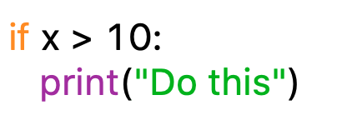
Conditional Statements
If : Runs the block of code only if the condition is true.
x
conditional
colon
x > 10
True
False
Do this!
indentation
Further code

Slide 5
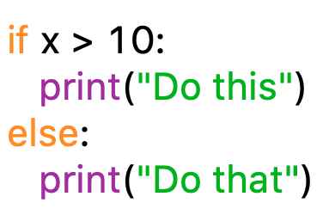
Conditional Statements
If... else...
Runs the block of code under “if” only if the condition is true.
Otherwise, runs the “else” code.
conditional
colon
colon
x > 10
indentation
indentation
if
True
False
else
Do this!
Do that!
Further code

Slide 6
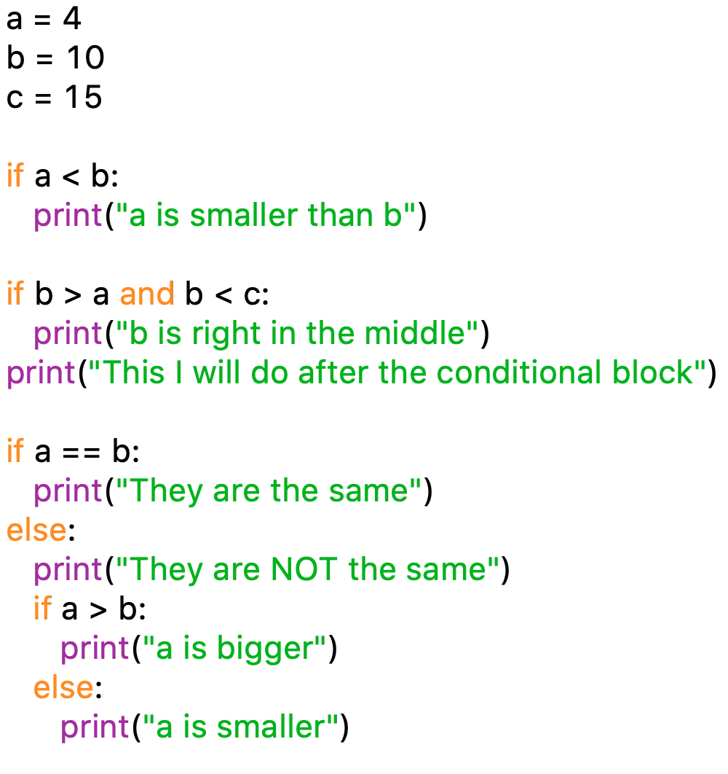
Conditional Statements
indentation defines blocks
inside the block
outside the block
nested conditions

Slide 7

Conditional Statements
else
False
False
x > 10
x < 10
x = 10
if
True
else if
True
Do this!
Do that!
Do something else!
conditional
indentation
Further code
conditional
indentation
If... elif.. else...
Runs the block of code under “if” only if the condition is true.
Otherwise, runs the block of code under “elif” only if the condition is true.
Otherwise, runs the “else” code otherwise.

Slide 8
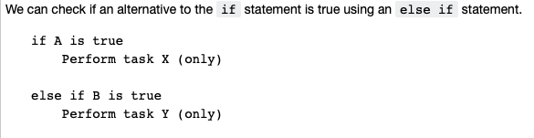
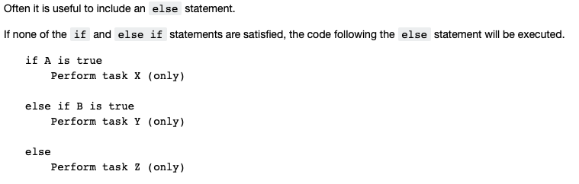

Slide 9
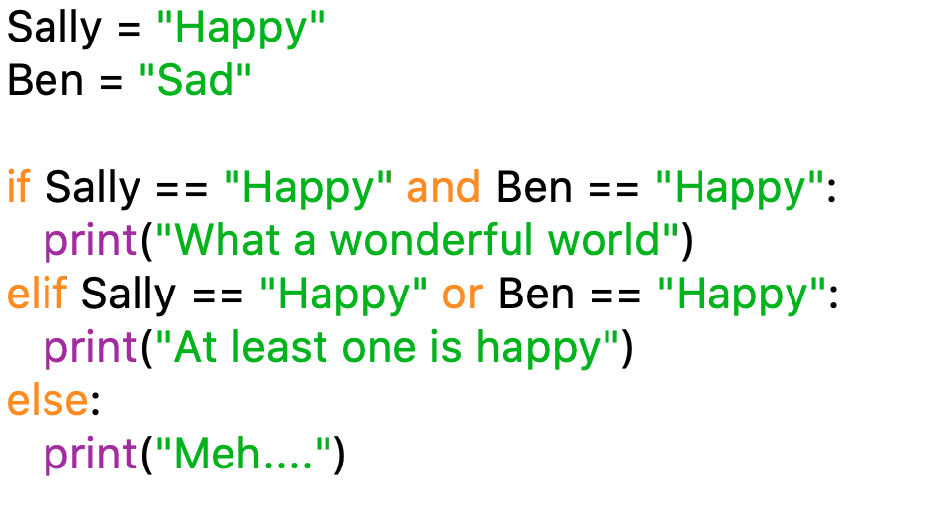
Chain of Conditional Statements
Conditional statements allow you to execute a block of code based on a condition.
Use boolean operators to compare two values: ==, !=, <=, >=, >, <.
Boolean logic is especially useful here: and, or.

Slide 10
Introduction to Computer Programming Lecture 2.3.b:
Time Telling Example
Department of Engineering Mathematics
Hemma Philamore

Slide 11
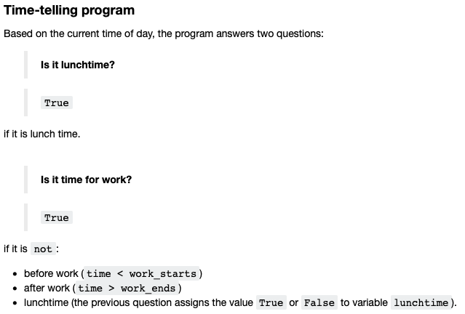

Slide 12
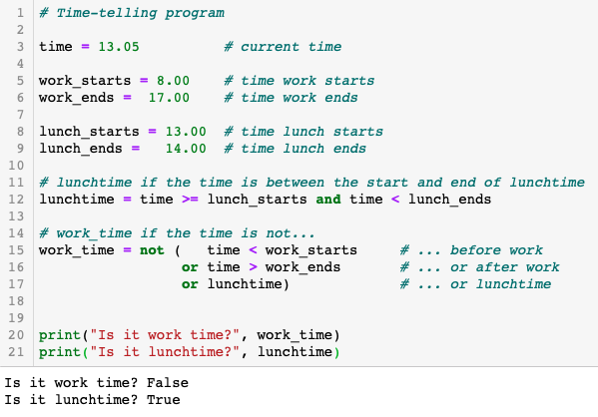

Slide 13

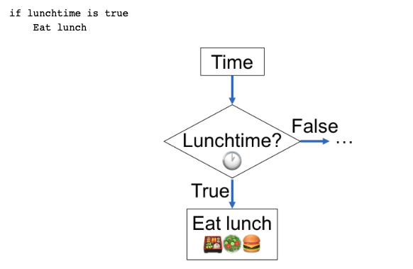

Slide 14
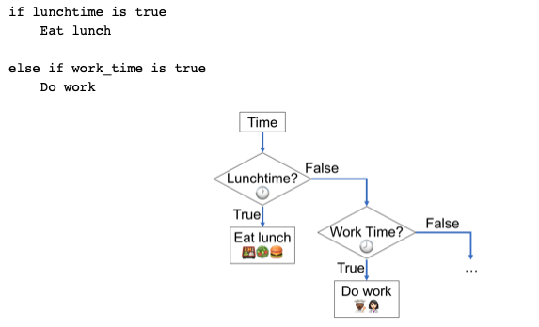

Slide 15
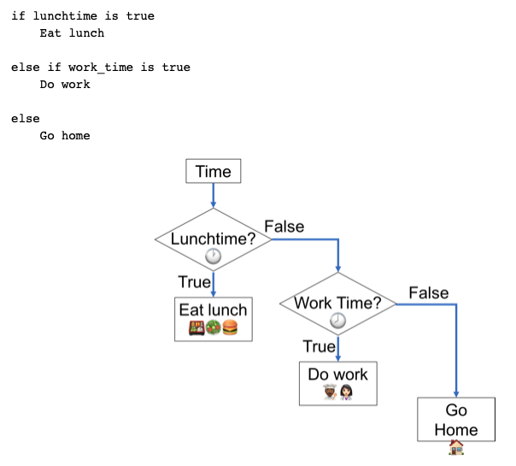

Slide 16
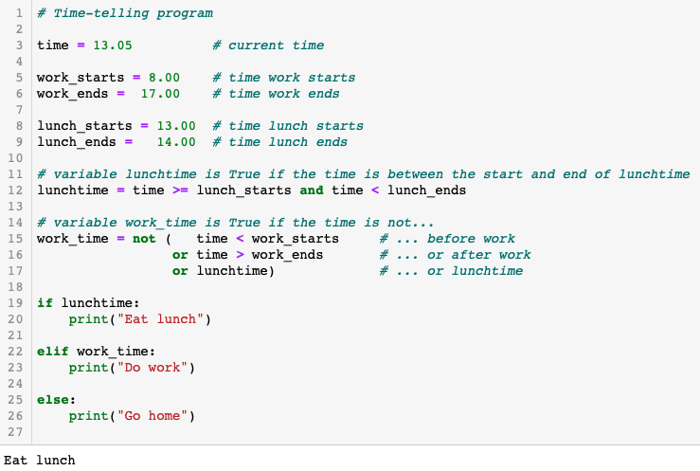

Slide 17
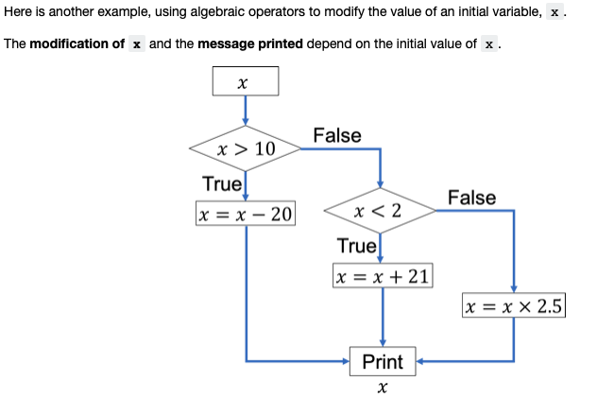

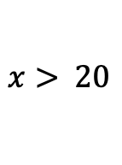
$$x> 20$$
$$5<x<10$$

Slide 18
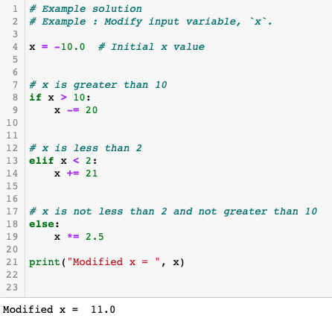

Slide 19
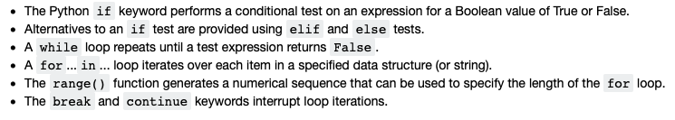
Summary
Control Flow

